Slide 1


Continuous Integration
Build software better, faster and cheaper

Slide 2
What is Continuous Integration?

Slide 3

Continuous Integration is a software development practice where members of a team integrate their work frequently, usually each person integrates at least daily - leading to multiple integrations per day. Each integration is verified by an automated build (including test) to detect integration errors as quickly as possible.
Martin Fowler

Slide 4
Principles
Maintain a Code Repository.
Automate the build.
Make the build self-testing.
Everyone commits to the baseline everyday.
Every commit to baseline should be built.
Keep build fast.
Make it easy to get the latest deliverables.
Everyone can see the result of the latest build.
Automate Deployment.

Slide 5








Workflow
Repository
Deploy
Pull
Generate
Reports
Push
Push
Push
Read
Developers

Slide 6

What happen if someone break the build?

Slide 7
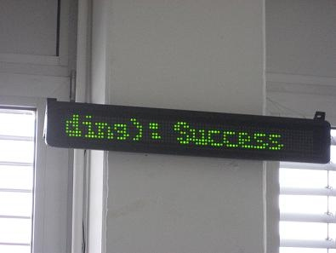



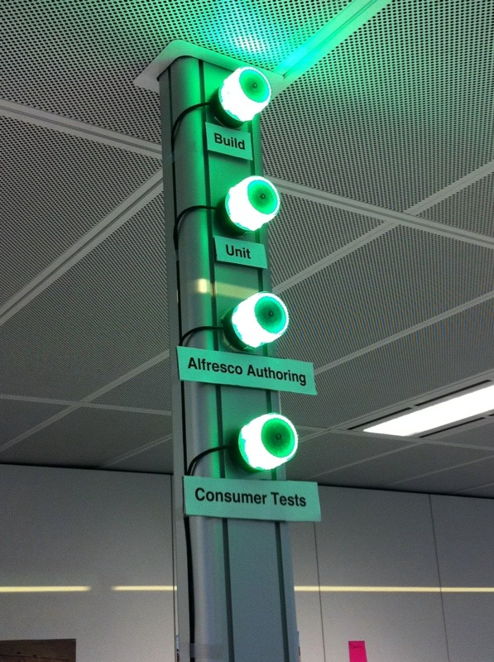

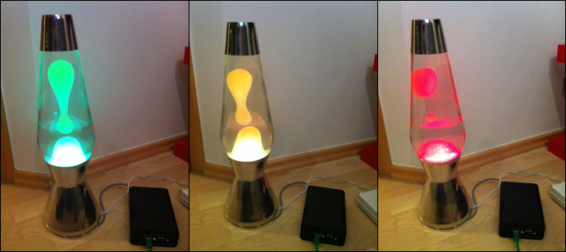
Some ideas

Slide 8

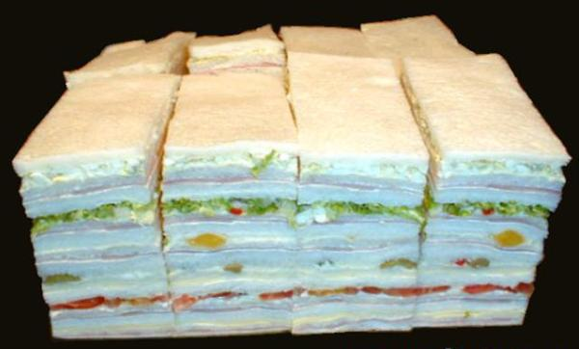
During the week
Break Pays
During the weekend

Slide 9
By the time it was released, Microsoft Windows NT 3.0 consisted of 5.6 million lines of code spread across 40,000 source files. A complete build took as many as 19 hours on several machines, but the NT development team still managed to build every day (Zachary, 1994). Far from being a nuisance, the NT team attributed much of its success on that huge project to their daily builds.
Steve Mcconel
http://www.stevemcconnell.com/ieeesoftware/bp04.htm

Slide 10
Benefits
It minimizes integration risk.
It reduces the risk of low quality.
It supports easier defect diagnosis.
Manage Versions – Installation Packages
Fail Fast
Build Better Software
That has more quality
That is tested early and often
That adheres to best practices and coding standards
Faster
Test in parallel not at the end
No integration points
Cheaper
Identify defects earlier
Fix when least costly
Easily repeatable testing

Slide 11

Better
That has more quality
That is tested early and often
That adheres to best practices and coding standards

Slide 12

Faster
Test in parallel not at the end
No integration points
No one have to integrate

Slide 13

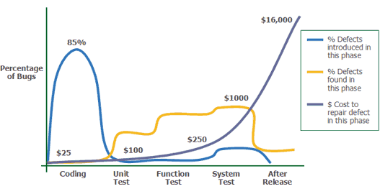
Cheaper
Identify defects earlier
Fix when least costly
Easily repeatable testing
Source: http://www.agitar.com/solutions/why_unit_testing.html

Slide 14
Tools
Debian– www.debian.org
Jenkins CI - www.jenkins-ci.org
Apache Ant – ant.apache.org
PHP QA Tools - www.phpqatools.org
PHP – www.php.net
Pear - www.pear.php.net

Slide 15
Pre-Requisites
Debian installed with
Web Server (Apache + PHP + Pear + etc.)
SSH server
Jenkins-ci (How to install Jenkins on Debian)
By default Jenkins will attend at http://debian-server-ip:8080
Git
PHP QA Tools
Apache Ant

Slide 16
Commands
#PHP 5 + PEAR
sudo apt-get install php-5
sudo apt-get install php-pear
#Jenkins
wget -q -O - http://pkg.jenkins-ci.org/debian/jenkins-ci.org.key | sudo apt-key add -
sudo sh -c 'echo deb http://pkg.jenkins-ci.org/debian binary/ > /etc/apt/sources.list.d/jenkins.list'
sudo apt-get update
sudo apt-get install jenkins
sudo pear upgrade PEAR
sudo pear config-set auto_discover 1
sudo pear install pear.phpqatools.org/phpqatools
sudo apt-get install git-core

Slide 17
Commands
#PHP QA Tools
sudo pear upgrade PEAR
sudo pear config-set auto_discover 1
sudo pear install pear.phpqatools.org/phpqatools
#Git
sudo apt-get install git-core

Slide 18
Commands
#Apache Ant
wget http://www.us.apache.org/dist/ant/binaries/apache-ant-1.9.2-bin.tar.gz
sudo tar xvfvz apache-ant-1.9.2-bin.tar.gz -C /opt
sudo ln -s /opt/apache-ant-1.9.2 /opt/ant
#Setup ANT_HOME
sudo sh -c 'echo ANT_HOME=/opt/ant >> /etc/environment'
sudo ln -s /opt/ant/bin/ant /usr/bin/ant
#Verify
ant -version

Slide 19
Jenkins Plugins
Checkstyle (for processing PHP_CodeSniffer logfiles in Checkstyle format)
Clover PHP (for processing PHPUnit code coverage xml output)
DRY (for processing phpcpd logfiles in PMD-CPD format)
HTML Publisher (for publishing the PHPUnit code coverage report, for instance)
JDepend (for processing PHP_Depend logfiles in JDepend format)
Plot (for processing phploc CSV output)
PMD (for processing PHPMD logfiles in PMD format)
Violations (for processing various logfiles)
xUnit (for processing PHPUnit logfiles in JUnit format)
GitHub Plugin
Jenkins Workspace Cleanup Plugin

Slide 20
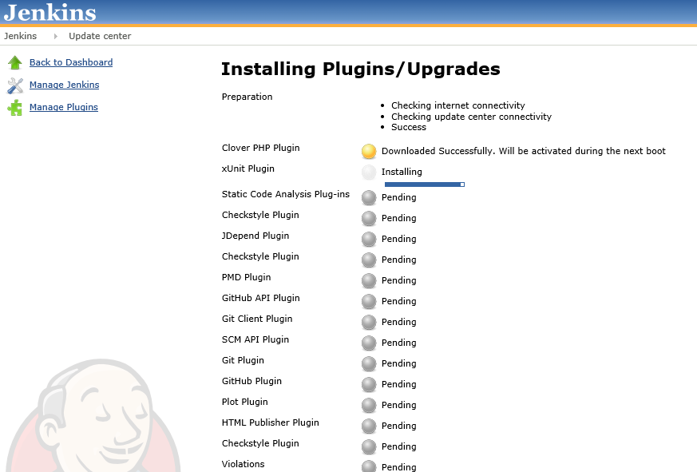
Jenkins Plugins

Slide 21
Generate a ssh key
Login with the Jenkins user
root@ciserver:# su - jenkins
Execute:
ssh-keygen -t rsa -C "your_email@example.com"
cat .ssh/id_rsa.pub
Copy the text and paste it as a new key in the Git Hub account

Slide 22
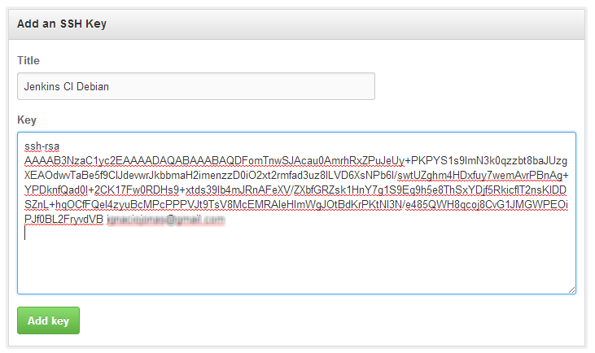
Add an SSH Key

Slide 23
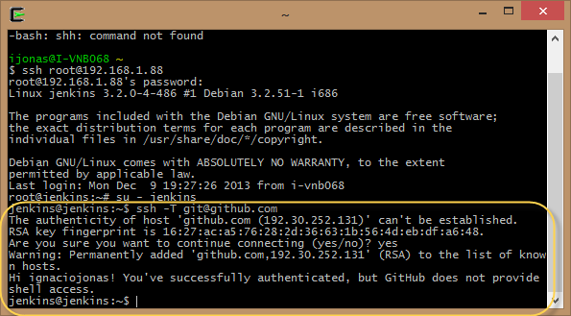
Authenticate against GitHub
Execute:
ssh -T git@github.com

Slide 24
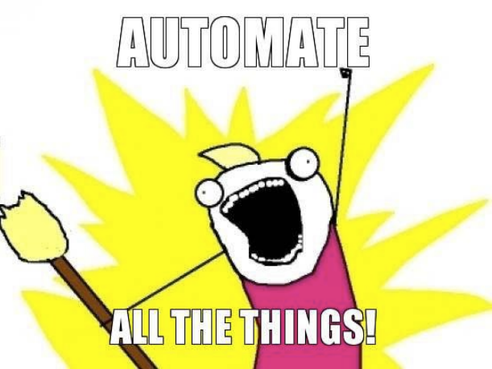
Lets Play!

